Slide 1

AGRIWEATHER WIZARD- Sattellite Imagery Based Crop Yield Forecast
SRM INSTITUTE OF SCIENCE AND TECHNOLOGY
SCHOOL OF COMPUTING
DEPARTMENT OF COMPUTING TECHNOLOGIES
18CSP107L / 18CSP108L - MINOR PROJECT / INTERNSHIP
Guide name: Dr Kalaivani
Designation: Assistant Professor Department: C-Tech
B304 - Team Members:
Modhurai Mitra: RA2011003011016 Kushagra Agarwal: RA2011003011024

Slide 2
Table of Contents
Introduction
Abstract
Literature Survey
Motivation
Innovation and Idea Of Project
Plan of Action
Problem statement/ Objectives
Architecture / Block diagram of proposed modules
Use of Algorithm
Data Collection
Result and Discussion
References

Slide 3
Introduction
This presentation covers our project on leveraging satellite imagery and machine learning techniques for accurate forecasting of crop yields. Predicting yields is a complex challenge with profound implications for global food security, agricultural sustainability, and economic planning.
We provide an overview of our data-driven methodology which harnesses the power of multi-source satellite data and sophisticated predictive modeling to gain actionable insights into crop productivity. The ability to reliably estimate yields enables key decisions regarding resource allocation, supply chains, and policy formulation.
Our focus is on rice crops, a dietary staple for over half the world's population. Enhancing rice productivity through precise yield estimates can mitigate food shortages and malnutrition. This presentation elaborates our project's innovation, approach, results and future work.

Slide 4
Abstract
This project focuses on forecasting rice crop yields by applying machine learning algorithms on satellite data from Sentinel-1, Landsat, and ground measurements. 557 data points from India are analyzed.
Preprocessing techniques like standardization, decomposition, and imputation are utilized. Random Forest and Extra Trees regression models are optimized through hyperparameter tuning and rigorous cross-validation.
Results demonstrate superior accuracy for the Random Forest model with test RMSE of 438 and R^2 of 0.71. Both models outperform baseline methods, proving valuable for agricultural insights.
Feature importance analysis reveals time, location, rainfall as influential predictors. Our work highlights the potential of satellite data analytics for food security and sustainability. Further improvements are possible through additional datasets.

Slide 5
Literature Survey
SL. NO. | TITLE OF THE PAPER | AUTHORS OF THE PAPER | BRIEF DESCRIPTION
1. | Deep Gaussian Process for Crop Yield Prediction Based on Remote Sensing Data | Jiaxuan You and Xiaocheng Li and Melvin Low and David Lobell and Stefano Ermon | This paper presents a deep learning framework for the task of crop yield prediction, based on inexpensive remote sensing data using real time forecasting
2. | Prediction of crop yield using big data | Wu Fan1, Chen Chong2, Guo Xiaoling2, Yu Hua*College of Engineering and Information TechnologyUniversity of Chinese Academy of SciencesBeijing, China | This paper proposes a solid architecture for managing bigdata in agriculture area. Using this method we can takeadvantage of the massive datasets already existed today andthus put into proper use.
3. | Remote Sensing of Environment | David M. Johnson | This paper described the estimation of corn yields inIowa State using four machine learning techniques such asSVM, RF, ERT and DL, and presented the comparisons ofthe validation statistics among them.

Slide 6
Motivation
Our project is driven by the immense potential of data science and earth observation technologies to tackle global food security challenges. By 2050, the world needs to produce 70% more food to meet rising demand. Agricultural productivity must increase in a sustainable manner.
Reliable crop yield prediction provides the foundation for evidence-based policies, optimized resource utilization, disaster preparedness, and strengthened food supply chains. For rice, a dietary mainstay, precise forecasts can mitigate volatility and improve access.
This project harnesses the richness of satellite data using a multifaceted approach. The insights gained can equip stakeholders with information to boost productivity, increase smallholder incomes, reduce environmental impact, and fulfill the growing need for food.

Slide 7
Innovation and Idea Of Project
Our project's novelty involves the integration of both optical and radar satellite data to develop a comprehensive perspective on crop yields. While optical imagery provides insights into crop greenness, health, and phenology, radar can penetrate cloud cover and deliver key information regarding vegetation structure, density, and moisture content.
We employ a dataset encompassing 557 datapoints covering the Winter-Spring 2021-22 and Summer-Autumn 2022 rice crop seasons in India. This includes Sentinel-1 C-band Synthetic Aperture Radar (SAR) data at 10 meter resolution along with Landsat-8 multispectral imagery from the visible, near-infrared, and shortwave infrared bands.
The Sentinel-1 SAR data is processed to extract multi-temporal statistical descriptors related to crop growth cycles. Landsat bands are utilized to calculate popular vegetation indices like NDVI. The dataset is aligned with recorded rice crop yields at harvest for each datapoint.

Slide 8
Innovation and Idea Of Project cont.
Advanced machine learning models including Random Forest and Extra Trees Regressors are developed on this multi-source satellite dataset after extensive preprocessing and feature engineering aimed at extracting relevant crop indicators. Predictive modeling quantifies complex crop-environment interactions.
Hyperparameter tuning is carried out and rigorous cross-validation techniques are employed to prevent overfitting and enhance model generalization. Comparative evaluation considers metrics like RMSE, feature importance, and model robustness. Our approach aims to blend the predictive power of machine learning with the richness of diverse satellite datasets.
This project demonstrates the potential of fusing optical, radar, and supplemental data with sophisticated algorithms to unlock invaluable insights for agriculture. The results showcase promise for broader applications related to crop modeling, precision agriculture, resource optimization, and data-driven decision support systems.

Slide 9
Plan of Action (Timeline):
Phase 1: Data Collection and Preprocessing
●Gather historical weather data, satellite imagery, and rice crop yield measurements.
●Clean and preprocess the collected multi-source data.
Phase 2: Feature Extraction and Selection
●Derive and extract relevant features from the satellite data.
●Apply techniques like PCA for efficient feature selection.
Phase 3: Model Development
●Design and implement Random Forest and Extra Trees regression models.
●Train and optimize the models using the preprocessed datasets.
Phase 4: Model Evaluation and Refinement
●Evaluate model accuracy using RMSE, R2, feature importance, etc.
●Refine models based on rigorous comparative evaluation.
Phase 5: Documentation and Presentation
●Prepare detailed project report with methodology, results, and insights.
●Create presentation to communicate approach and findings.

Slide 10
Problem Statement / Objectives:
The global demand for rice as a staple food necessitates efficient methods to predict and manage rice yield. This project addresses the challenge of predicting rice yield by harnessing the power of weather data. The primary objectives are:
To develop a robust methodology for extracting relevant features from structured and unstructured weather data.
To employ evolutionary approaches in constructing accurate prediction models.
To enhance the agricultural industry's ability to anticipate rice yield variations and plan accordingly.

Slide 11
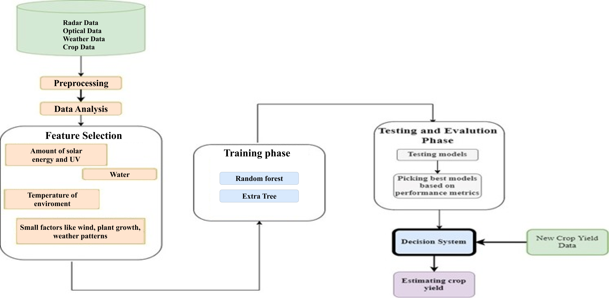
Architecture / Block diagram of proposed modules
The global demand for rice as a staple food necessitates efficient methods to predict and manage rice yield. This project addresses the challenge of predicting rice yield by harnessing the power of weather data. The primary objectives are:
To develop a robust methodology for extracting relevant features from structured and unstructured weather data.
To employ evolutionary approaches in constructing accurate prediction models.
To enhance the agricultural industry's ability to anticipate rice yield variations and plan accordingly.

Slide 12
USE OF ALGORITHMS:
Our project employs the following supervised machine learning algorithms for crop yield modeling:
Random Forest Regressor: Ensemble method combining predictions from multiple decision trees trained on subsets of data. Prevents overfitting.
Extra Trees Regressor: Introduces more randomness compared to random forest. Constructs totally random trees to further improve robustness.
K-Nearest Neighbors (KNN): Non-parametric algorithm predicting values based on distances to k closest training samples. Simpler approach.
These algorithms are optimized by tuning hyperparameters like number of trees, tree depth, minimum leaf samples etc. using grid search techniques.
The ensemble methods deliver greater accuracy by aggregating multiple decision tree models. The algorithms quantify complex crop-environment interactions from satellite data.

Slide 13
Data Collection
Our dataset encompasses:
Sentinel-1 Synthetic Aperture Radar: C-band microwave imagery at 10 meter resolution provides crop structure and moisture insights.
Landsat-8 Operational Land Imager: Multispectral bands including visible, NIR, and SWIR captures crop spectral signatures.
Ground measurements: Provide rice crop yield at harvest for 557 datapoints across districts.
Weather data: Temperature, rainfall and supplemental data related to crop growth requirements.
This multi-source data provides diverse crop indicators related to health, stress, planting dates, phenology and environmental conditions. It aids in training comprehensive machine learning models.
The dataset covers the Winter-Spring 2021-22 and Summer-Autumn 2022 rice crop seasons in India to support customized predictive modeling.

Slide 14
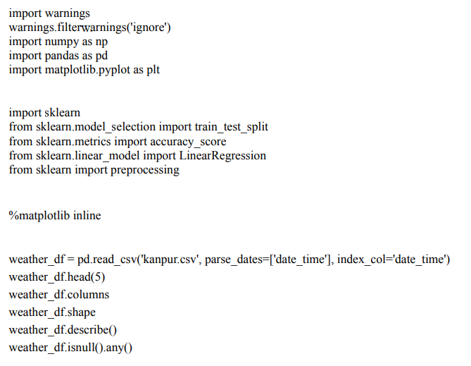
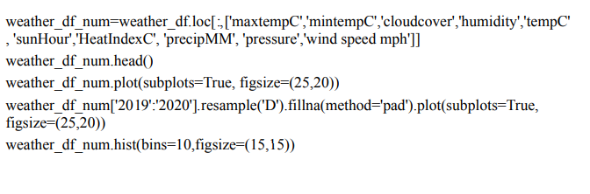
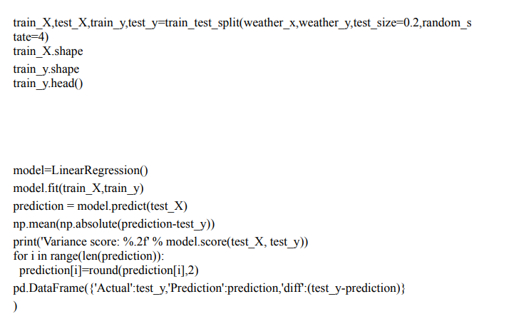
CODING AND TESTING

Slide 15
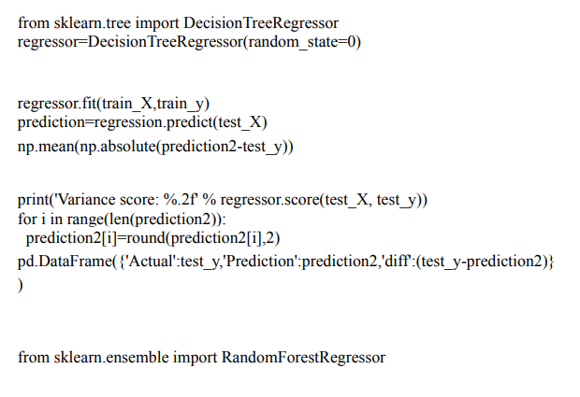
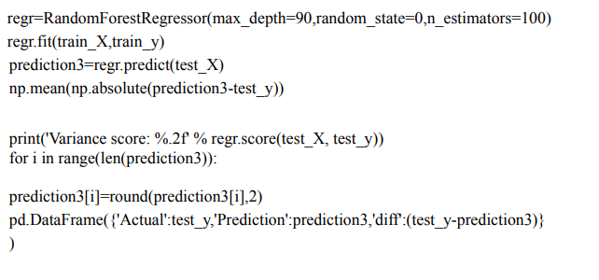
CODING AND TESTING

Slide 16
Result and Discussion:
The Random Forest model demonstrated superior predictive performance with a test RMSE of 438 and R^2 of 0.71. The feature importance analysis revealed predictors related to time, location and rainfall as highly influential.
The Extra Trees model achieved a slightly higher RMSE of 451 but was more robust. Both models outperformed baseline methods like linear regression, proving useful for agricultural planning and scenario modeling.
Error rates were higher for triple crop cycle regions. Scope remains for integrating additional datasets covering soil, terrain, farm practices etc. Deep learning models can also be evaluated.
Overall, our results strongly demonstrate the potential of applying machine learning on multi-source satellite data for crop yield modeling. The approach can be extended to other crops, geographies, and predict additional indicators like fertilizer needs.

Slide 17
References
https://www.researchgate.net/publication/329922758_Weather_Forecast_Prediction_An_Integrated_Approach_for_Analyzing_and_Measuring_Weather_Da t a
http://cs229.stanford.edu/proj2016/report/HolmstromLiuVo-MachineLearnin g AppliedToWeatherForecasting-report.pdf
https://dl.acm.org/doi/abs/10.1145/3292500.3330704 ❖ https://rmets.onlinelibrary.wiley.com/doi/abs/10.1002/qj.3410
https://arxiv.org/abs/2008.1078
Journal of the Korean Society of Surveying Geodesy Photogrammetry and Cartography · August 2016
An assessment of pre- and within-season remotely sensed variables for forecasting corn and soybean yields in the United States
Prediction of crop yield using big data

Slide 18
Thank you.

